Slide 1

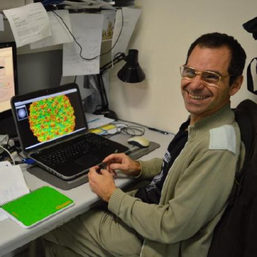

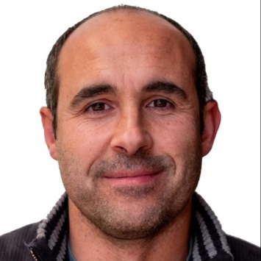




Roberto Marabini
Marcos Grajera
Pablo Conesa
Marta Martínez
I2PC COURSE ON
SINGLE PARTICLE ANALYSIS
AND MODELLING BY CRYO-EM
CNB-CSIC, Madrid, June 16th – June 20th, 2025

Slide 2

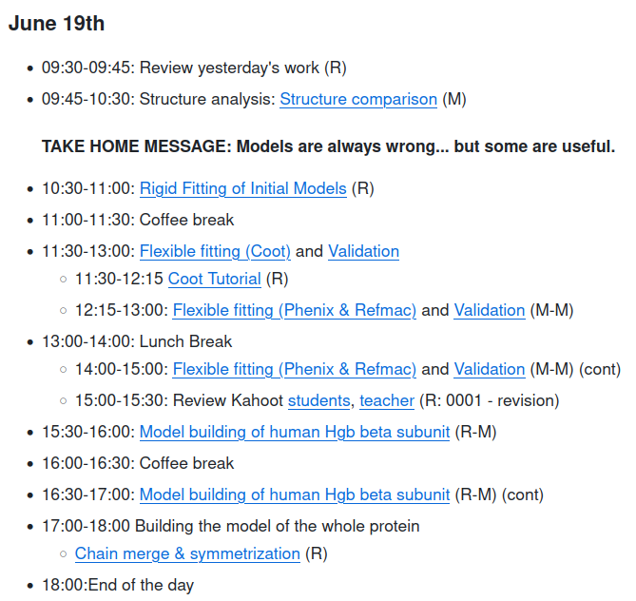
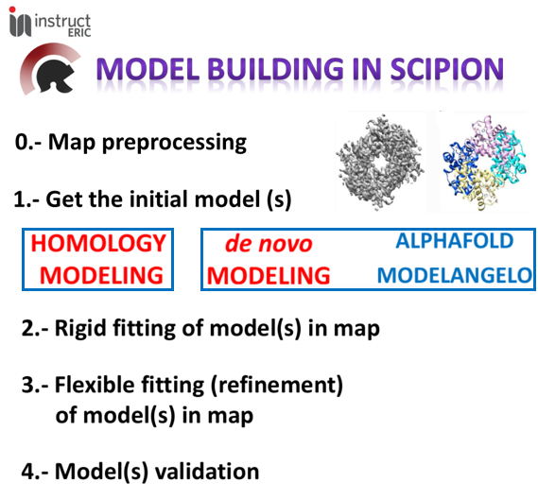
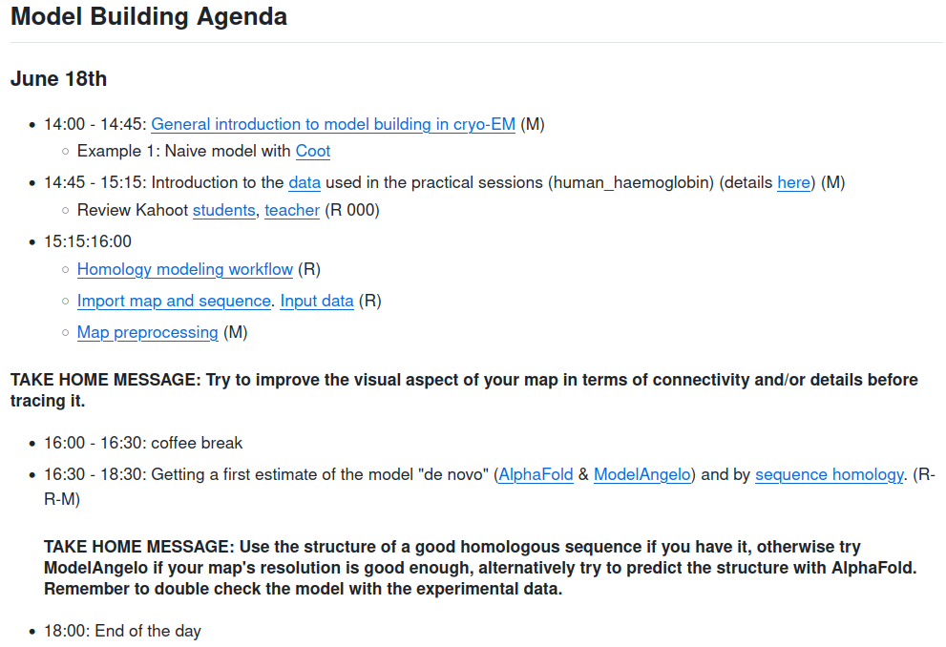
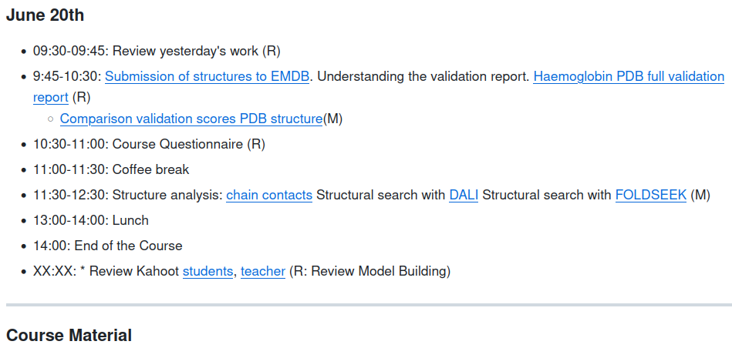
https://github.com/I2PC/scipion-courses/wiki/Course_June16-20_2025
I2PC Course on Single Particle analysis and modelling by Cryo-EM. Madrid, June 16 - 20, 2025

Slide 3
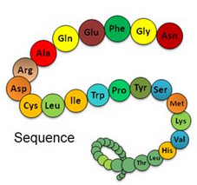
Our ultimate goal: To characterize the structure of macromolecules
Why is it important to characterize the
structure of macromolecules
(protein complexes)?
Clues about function and dynamics (sensible domains/motifs)
Clues about interacting partners (complexes)
Deleterious effect of mutations (diseases)
Designing of inactivating drugs
Eventually: Basic knowledge to train AI methods
Predict structures from sequence (AlphaFold)
Design new proteins

Slide 4
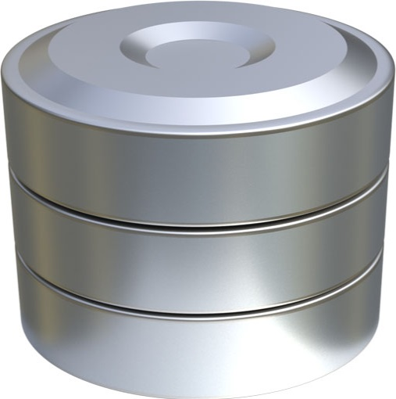

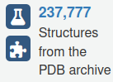
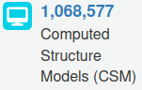

Our ultimate goal: To characterize the structure of proteins
XRD-crystals
Cryo-EM
NMR
Why is it important to characterize the
structure of macromolecules
(protein complexes)?
PDB
Clues about function and dynamics (sensible domains/motifs)
Clues about interacting partners (complexes)
Deleterious effect of mutations (diseases)
Designing of inactivating drugs
Eventually: Basic knowledge to train AI methods
Predict structures from sequence (AlphaFold)
Design new proteins
Q-scores
Integrative modeling: combines spatial restraints derived from a variety of biophysical techniques to determine the 3D structure of complex macromolecular assemblies.

Slide 5
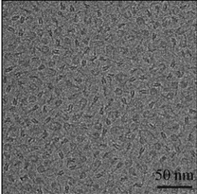
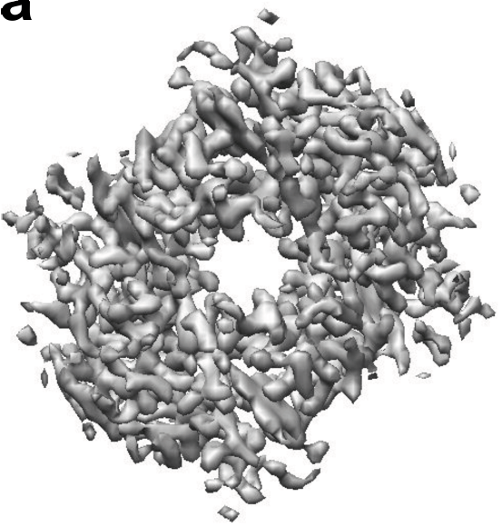
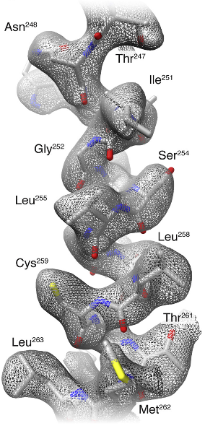
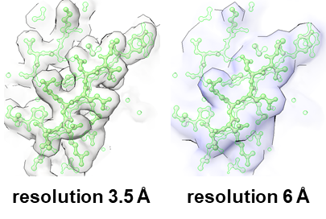
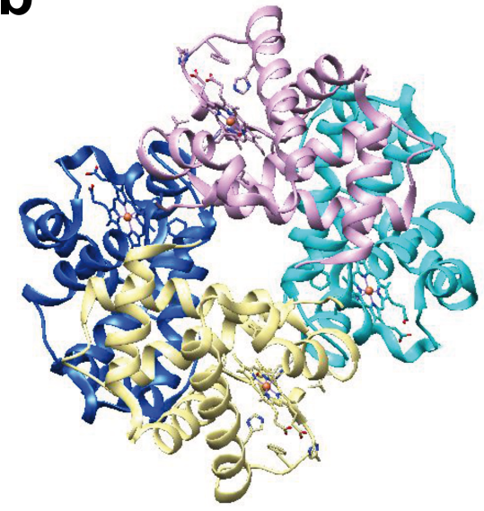
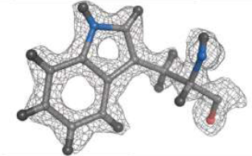
Modeling proteins from cryo-EM data
Approach to the problem: Atomic interpretation of the map
Density map
Model building
SPA/STA workflow
Best map !!!
Resolution (global and local):
< 4.0 to 4.5 Å
Atomic model
(Khoshouei et al., 2017)

Slide 6
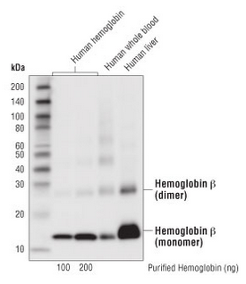
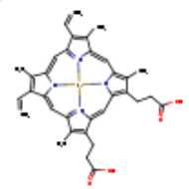
Modeling proteins from cryo-EM data
Approach to the problem: Atomic interpretation of the map
Density map
Model building
SPA/STA workflow
www.cellsignal.com
2 Hemoglobin subunit α (141 aa)
4 HEME
2 Hemoglobin subunit β (146 aa)
Best map !!!
Resolution (global and local):
< 4.0 to 4.5 Å
In real world sometimes
you don’t have all data
Atomic model
(Khoshouei et al., 2017)

Slide 7
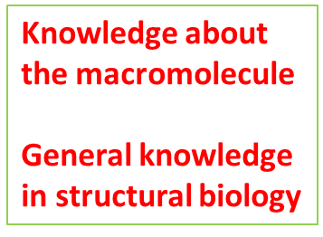
Modeling proteins from cryo-EM data
Approach to the problem: Atomic interpretation of the map
Density map
Model building
SPA/STA workflow
www.cellsignal.com
2 Hemoglobin subunit α (141 aa)
4 HEME
2 Hemoglobin subunit β (146 aa)
Best map !!!
Resolution (global and local):
< 4.0 to 4.5 Å
Atomic model
Best structure!!!
(Khoshouei et al., 2017)

Slide 8

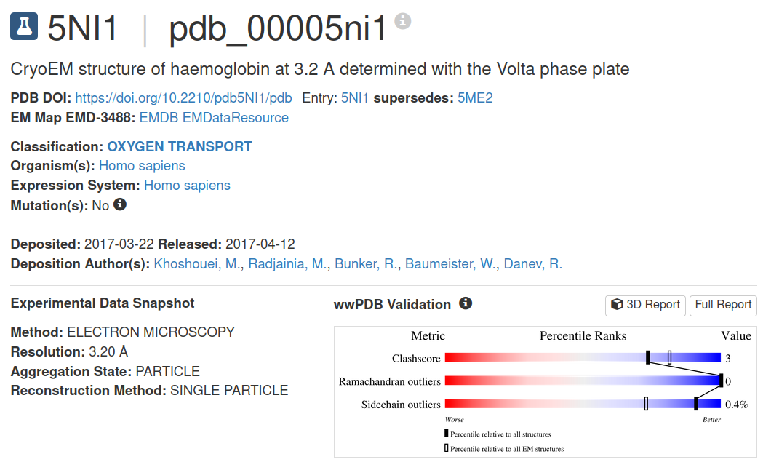
Modeling proteins from cryo-EM data
Approach to the problem: Atomic interpretation of the map
Electron density map
“All models are wrong, but some are useful”
(George P. Box)
Atomic model
(Khoshouei et al., 2017)

Slide 9
Modeling proteins from cryo-EM data
Model building
Basic steps (workflow)
Tools

Slide 10
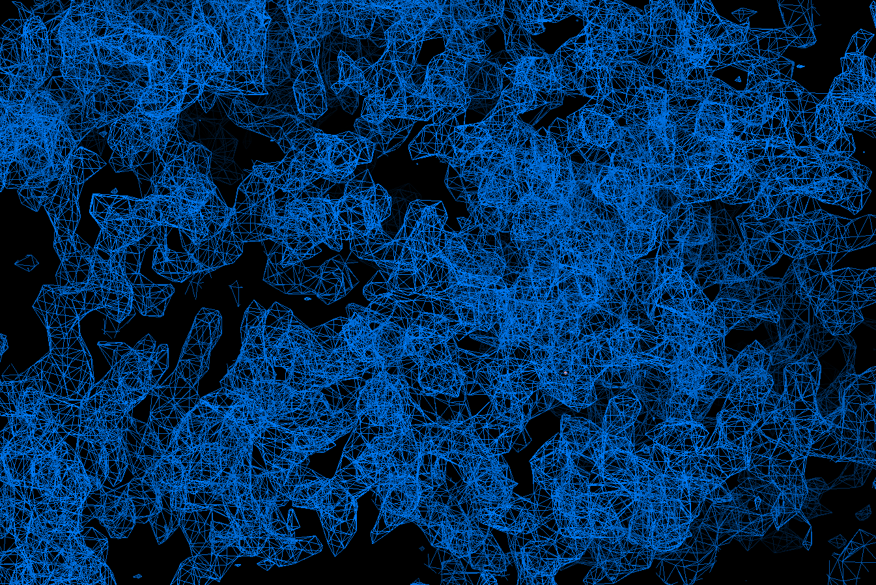
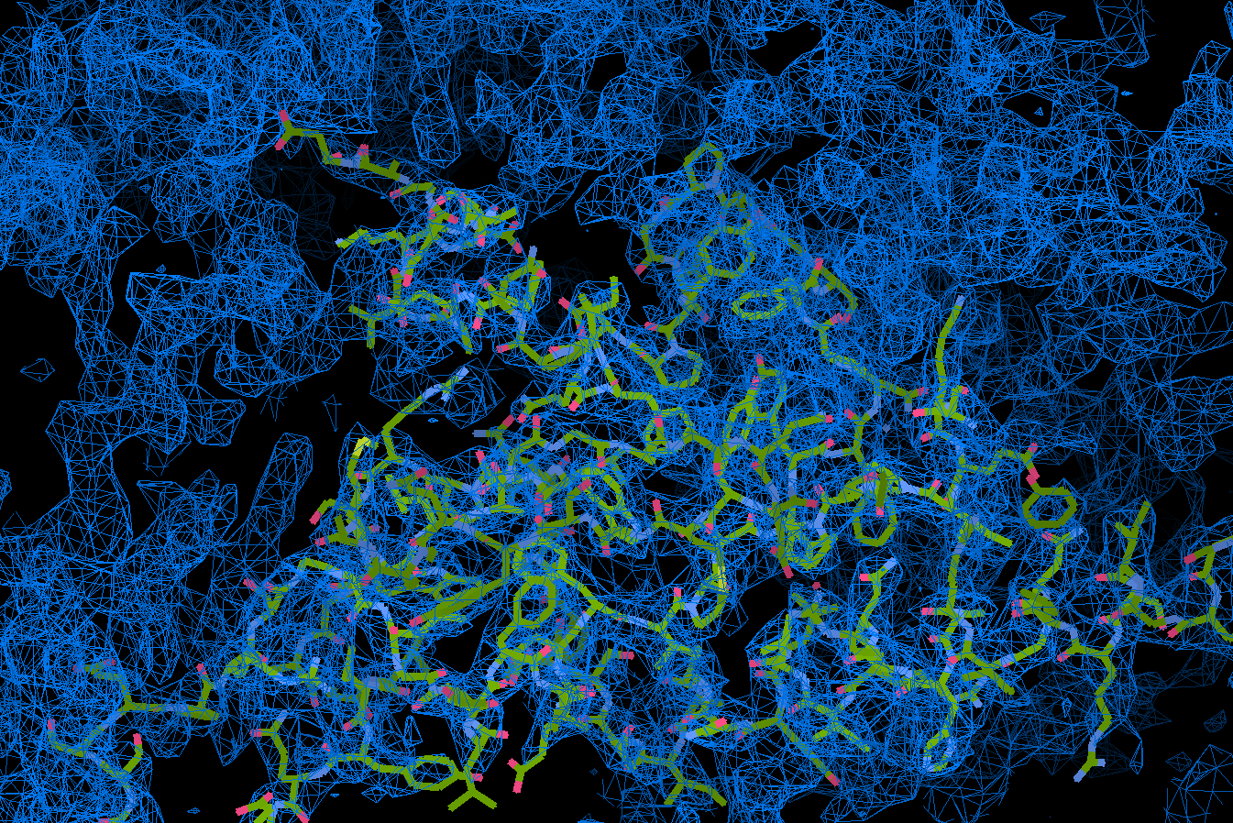

Modeling proteins from cryo-EM data
https://github.com/I2PC/scipion-courses/wiki/modeling_with_coot
SEED

Slide 11
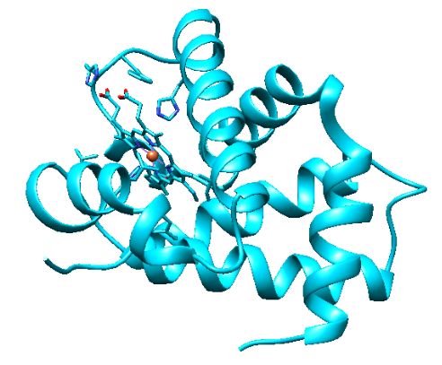
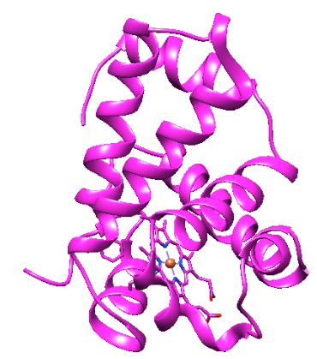
Step 1.- Getting the initial model(s): Structure prediction
de novo
modeling
AlphaFold
ModelAngelo
www.cellsignal.com
4 HEME
2 Hemoglobin subunit α (141 aa)
2 Hemoglobin subunit β (146 aa)
SEQUENCE

Slide 12

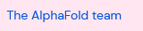

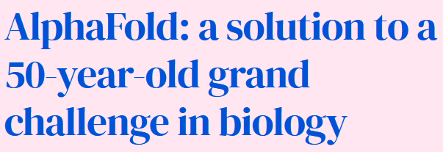
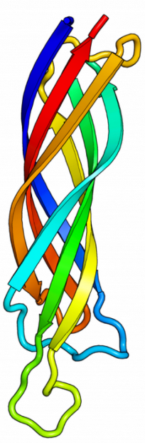
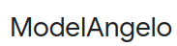
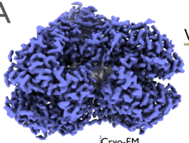
Step 1.- Getting the initial model(s): Structure prediction
de novo
modeling
3D structure
AlphaFold
ModelAngelo
c
Sequence
PDB
3D structure
c
Cryo-EM map

Slide 13
Step 1.- Getting the initial model(s): Structure prediction
de novo
modeling
AlphaFold
ModelAngelo
www.cellsignal.com
4 HEME
2 Hemoglobin subunit α (141 aa)
2 Hemoglobin subunit β (146 aa)
SEQUENCE

Slide 14
Step 1.- Getting the initial model(s): Structure prediction
de novo
modeling
Homology
modeling
AlphaFold
ModelAngelo
Our proteins borrow
the structure
of similar proteins
www.cellsignal.com
4 HEME
2 Hemoglobin subunit α (141 aa)
(template optional)
(template)
2 Hemoglobin subunit β (146 aa)
SEQUENCE
initial model = real model
1st clue:
Skeleton of α carbons
and
many side chains

Slide 15
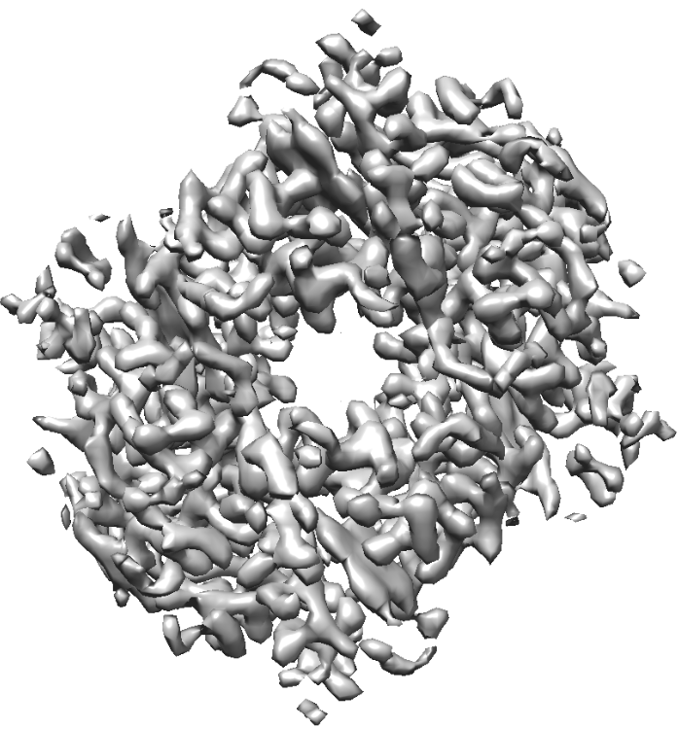
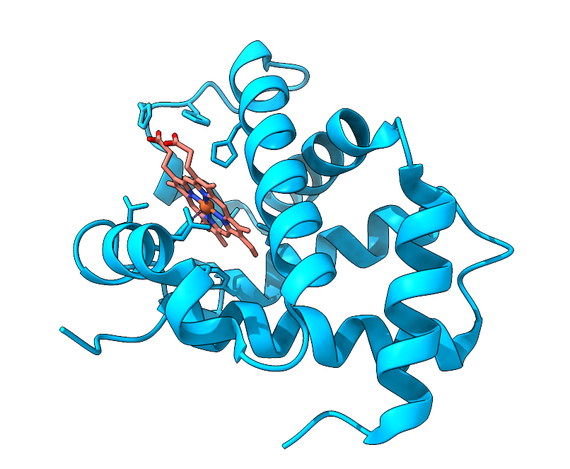
Step 2.- Rigid fitting of model(s) in map

Slide 16
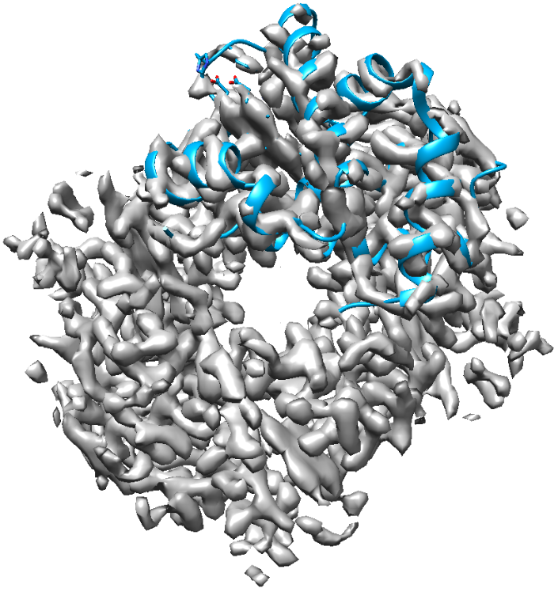
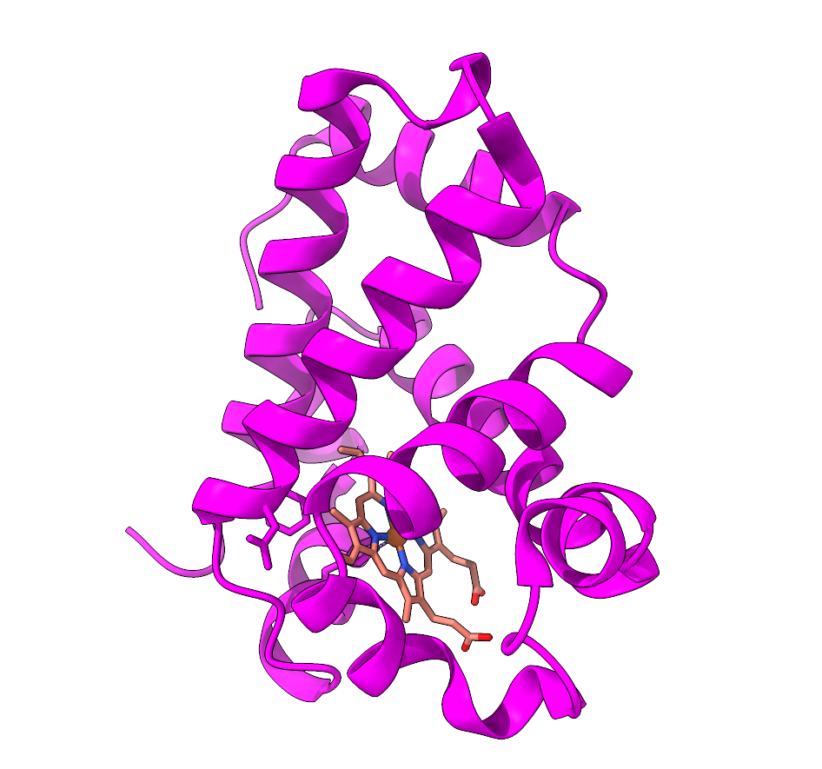
Step 2.- Rigid fitting of model(s) in map

Slide 17
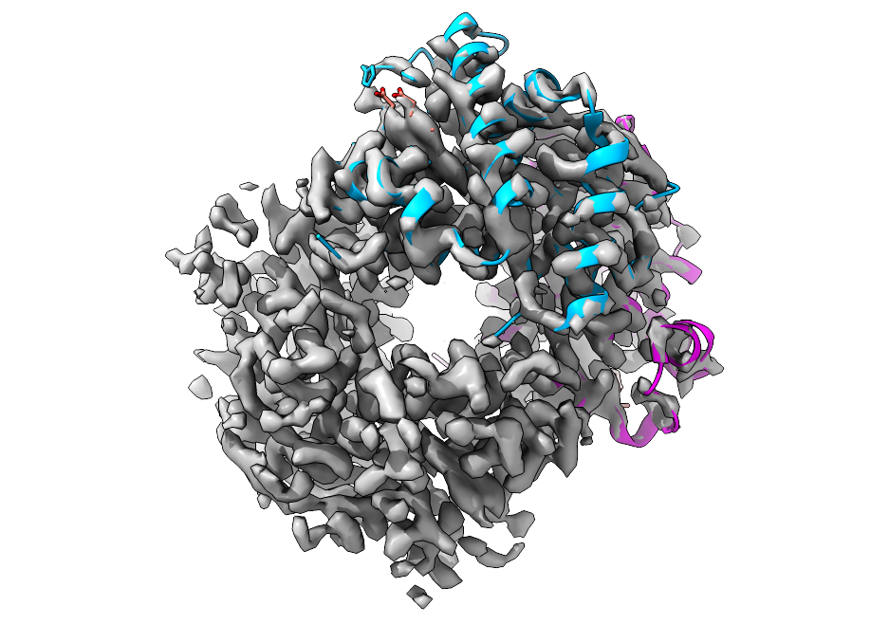
Step 2.- Rigid fitting of model(s) in map

Slide 18
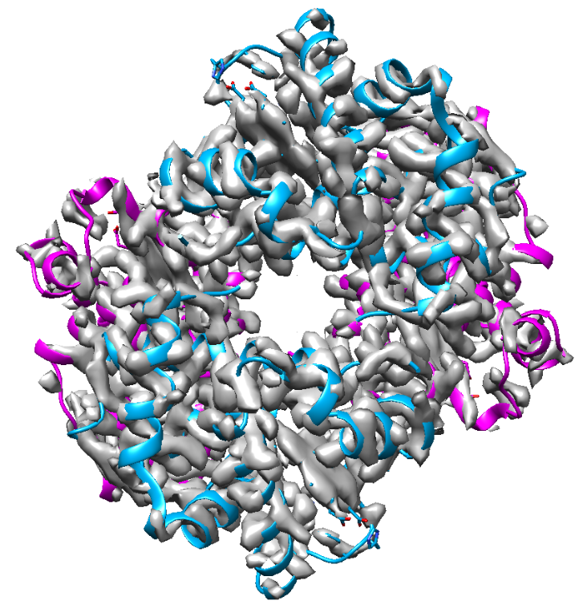
Step 2.- Rigid fitting of model(s) in map
Strategy

Slide 19
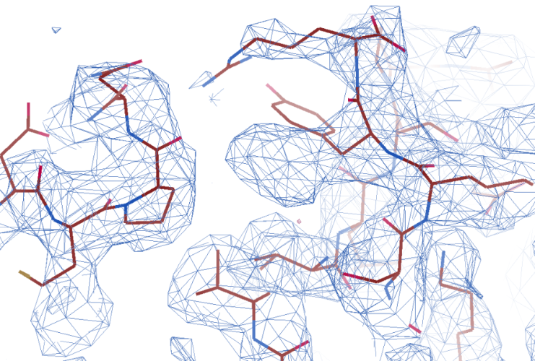
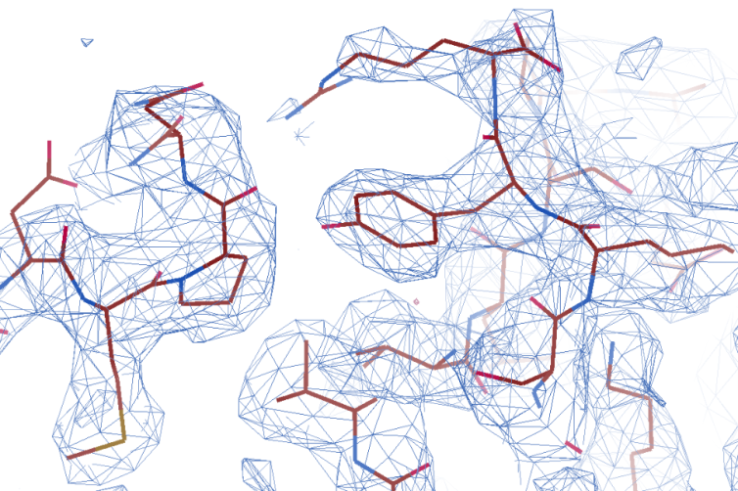
Step 3.- Flexible fitting (refinement) of model(s) in map
Getting the final model(s)
Manual and automatic

Slide 20
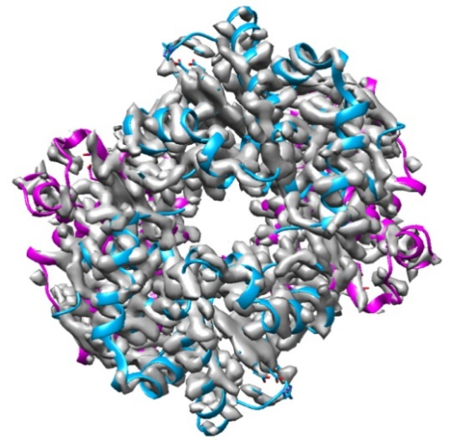
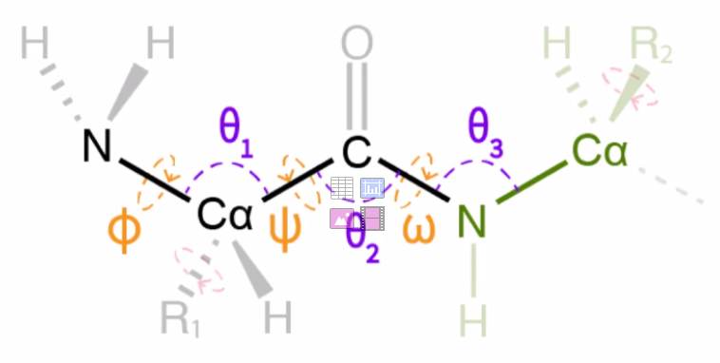


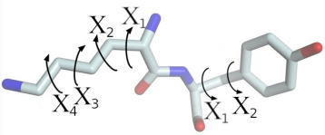
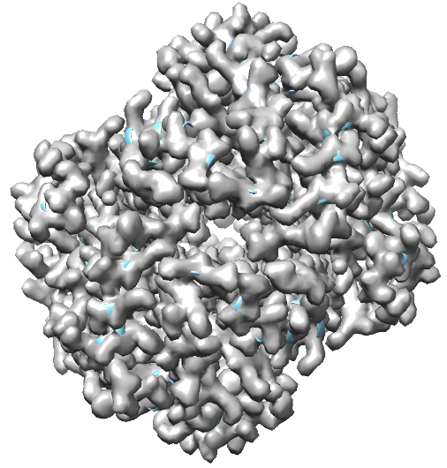

Step 4.- Model(s) validation
Is this structure reliable?
Map and model similarity
Geometry
Map/model
fitting
PDB
Is this structure similar
to the structures of the database?
(Bond lengths, angles, contacts …)
Is the map derived from the model similar to the original map?
Q (Submission)

Slide 21
Modeling proteins from cryo-EM data
Model building
Basic steps
1.- Get the initial model (s)
2.- Rigid fitting of model(s) in map
3.- Flexible fitting (refinement)
of model(s) in map
4.- Model(s) validation
Tools

Slide 22
Modeling proteins from cryo-EM data
Model building
Basic steps
1.- Get the initial model (s)
2.- Rigid fitting of model(s) in map
3.- Flexible fitting (refinement)
of model(s) in map
4.- Model(s) validation
Tools

Slide 23
Modeling proteins from cryo-EM data
Model building
Basic steps
0.- Map preprocessing
1.- Get the initial model (s)
2.- Rigid fitting of model(s) in map
3.- Flexible fitting (refinement)
of model(s) in map
4.- Model(s) validation
Tools

Slide 24
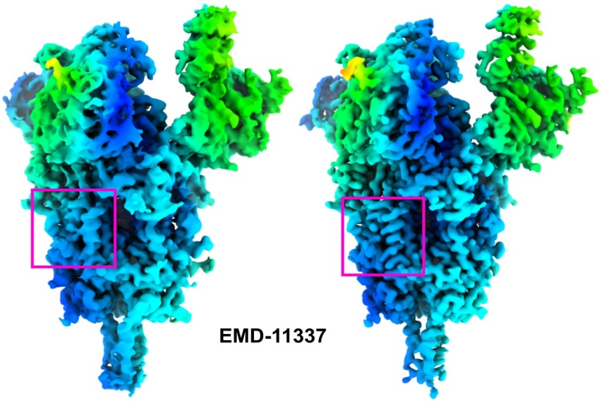
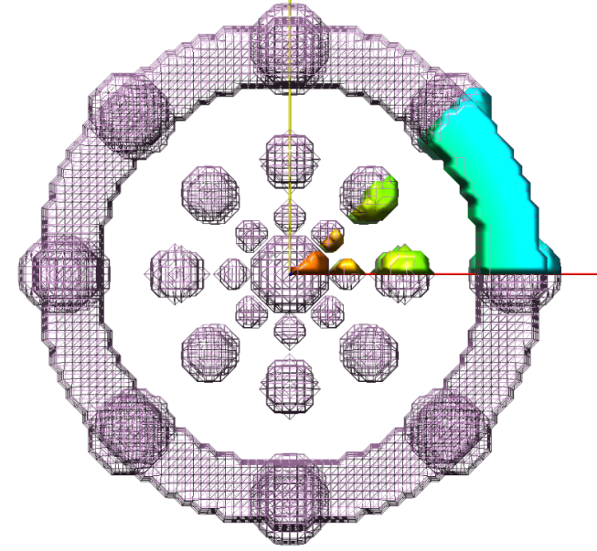
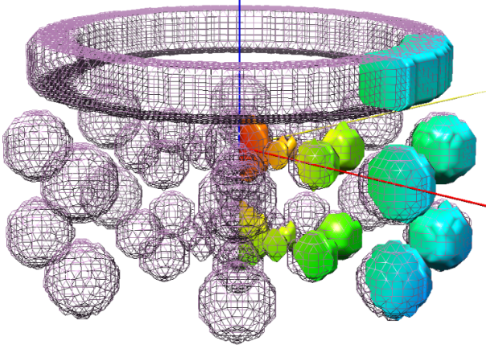
Step 0.- Map preprocessing
Map optimization
(sharpening, improving density)
Global and/or locally
DeepEMhancer (Sánchez et al., 2020)
Extract asymmetric unit (geometrical)
sym C8

Slide 25
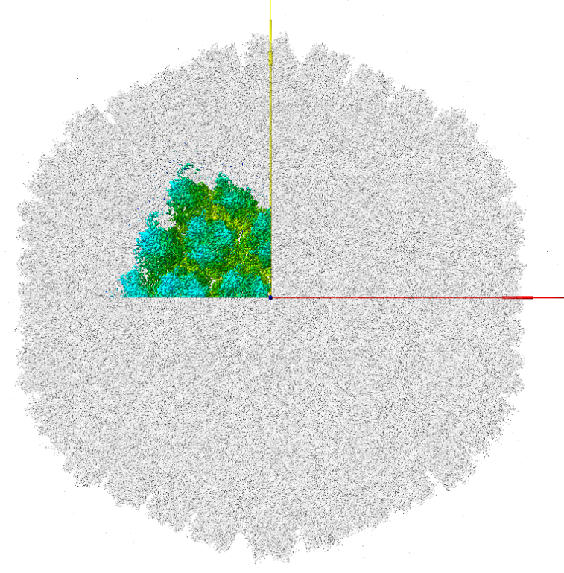
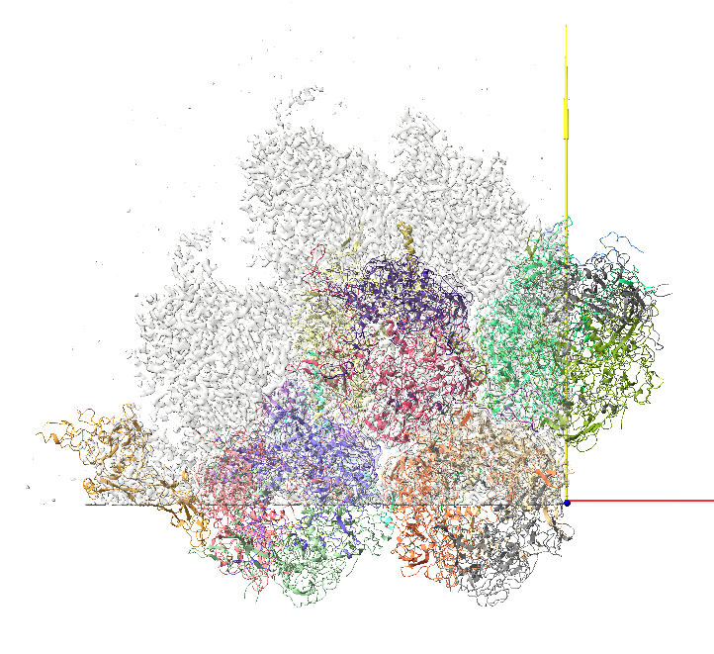
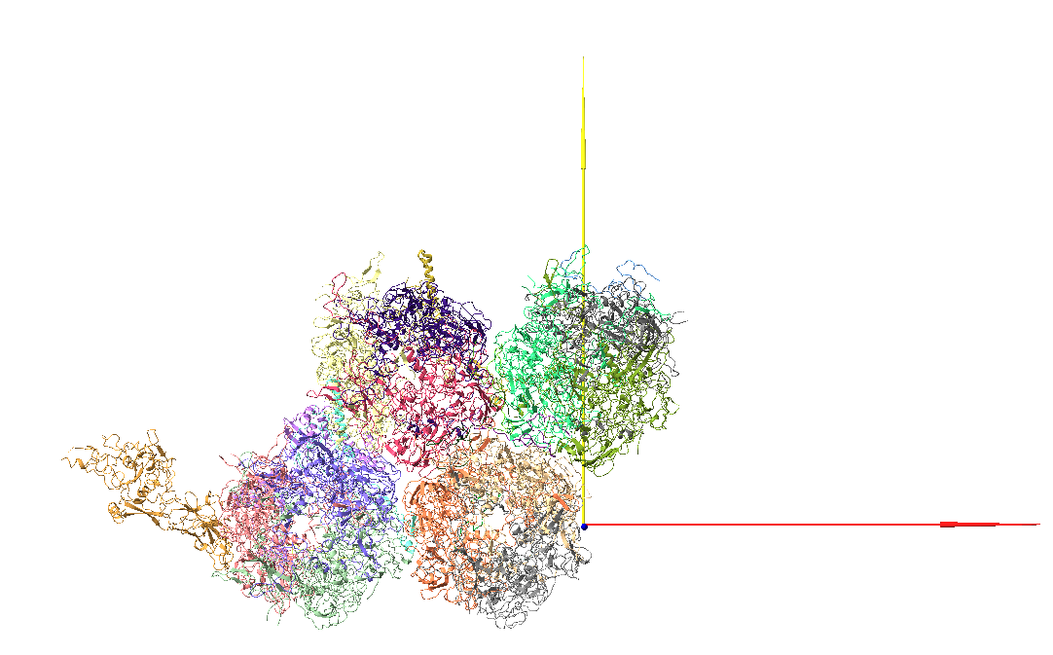
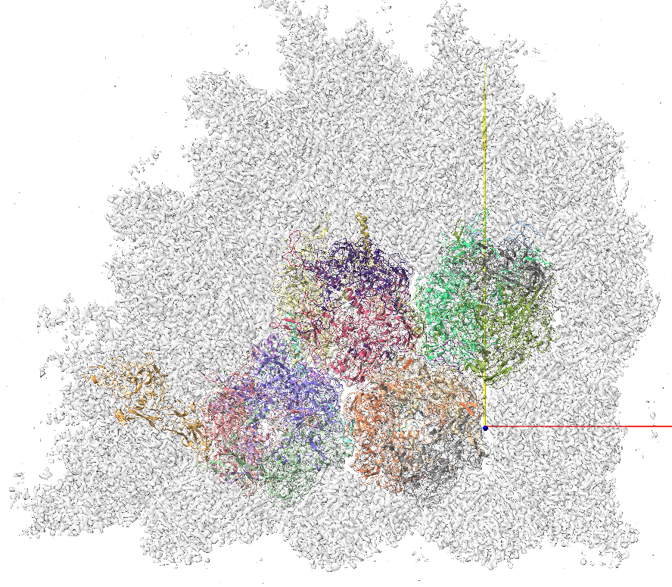
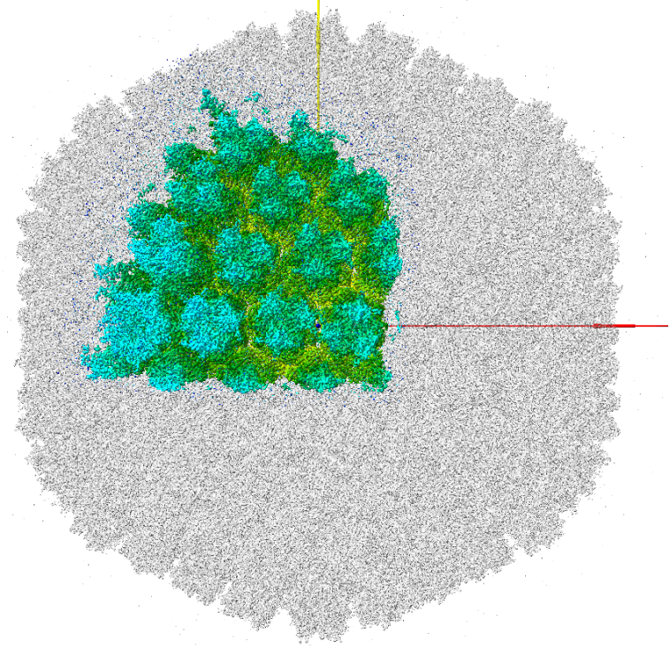
Asymmetric unit
(geometrical)
EMD-10768
6YBA
(biological)

Slide 26
Modeling proteins from cryo-EM data
Model building
Basic steps
0.- Map preprocessing
1.- Get the initial model (s)
2.- Rigid fitting of model(s) in map
3.- Flexible fitting (refinement)
of model(s) in map
4.- Model(s) validation
Tools

Slide 27



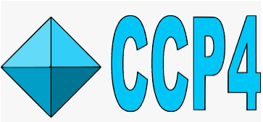


Tools
* Borrowed from crystallography
* Specifically designed for cryo-EM data
Programs & Suites
Interactive & Automatic

Slide 28


Martínez M et al. Integration of Cryo-EM Model Building Software in Scipion. J Chem Inf Model. 2020

Slide 29



https://scipion-em.github.io/docs/release-3.0.0/docs/user/user-documentation.html#model-building

